Slide 1
Java programming
Surya Uppara
20384123

Slide 2
index
Class
Objects
Methods
Constructors

Slide 3
class
A group of objects which have common properties is called as Class.
It is blueprint from which objects are created.
A Class in Java can contain:
Fields
Methods
Constructors
Blocks
Nested class and interface

Slide 4
To create a class, we use the keyword class
Syntax:
access modifier class<class name>
{
Fields;
method;
}

Slide 5
objects
An object is any entity of class that has a state and behaviour.
State: represents the data of an object.
Behavior: represents the functionalities of an object
For example if we consider car as an object, then its state is - name, colour, and the behaviour is - travelling
To create an object of Example,
Specify the class name, followed by the object name, and use the keyword new

Slide 6
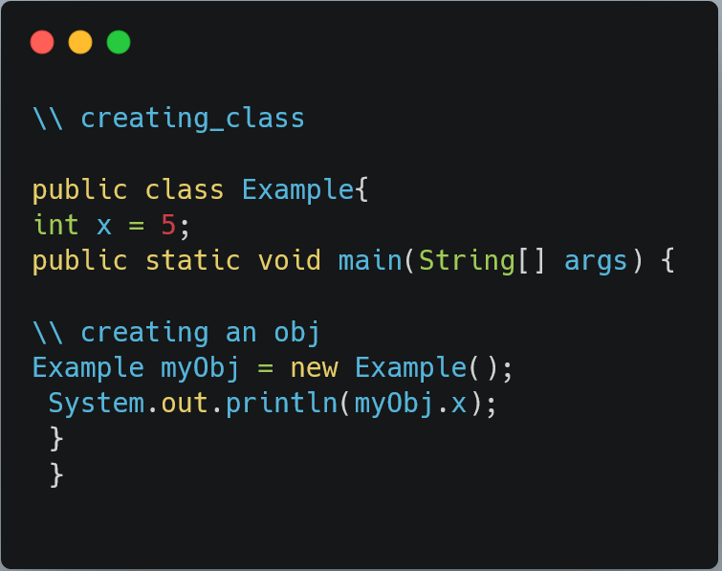
Output:
5

Slide 7
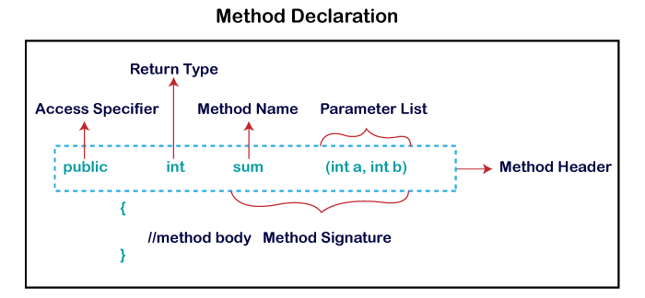
methods
A method is a block of code or collection of statements or a set of code grouped together to perform a certain task or operation.
It is used to achieve the reusability of code.

Slide 8
Java Constructors

Slide 9
Constructors
Constructors in java are used to create the instance of the class
Constructors are almost similar to methods expect for two
Its name is same as class name
It has no return type

Slide 10
Types of Constructors
Default
constructor
no-argument
constructor
Parameterized
constructor
Copy
constructor

Slide 11
Default constructor
A default constructor is automatically created at the time of object creation, if no constructor is declared in the class. This type of constructor is not visible in the program.
NO-ARGUMENT CONSTRUCTOR
No-argument constructors are visible in the class, unlike default constructors. Also, it has a constructor definition but without arguments (or parameters). They get the call when the object of the class creates.

Slide 12
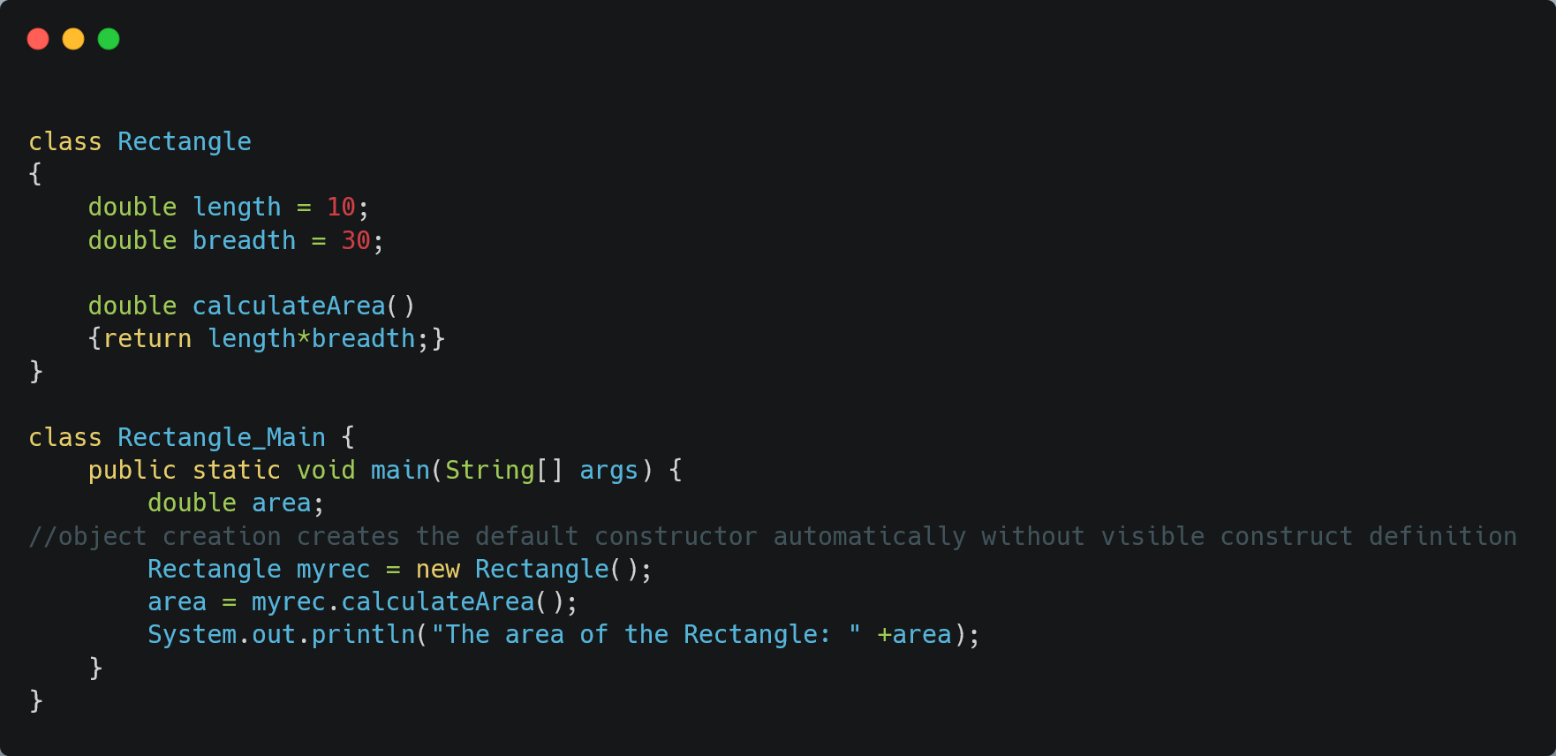
Output:
The area of the Rectangle: 300.0

Slide 13
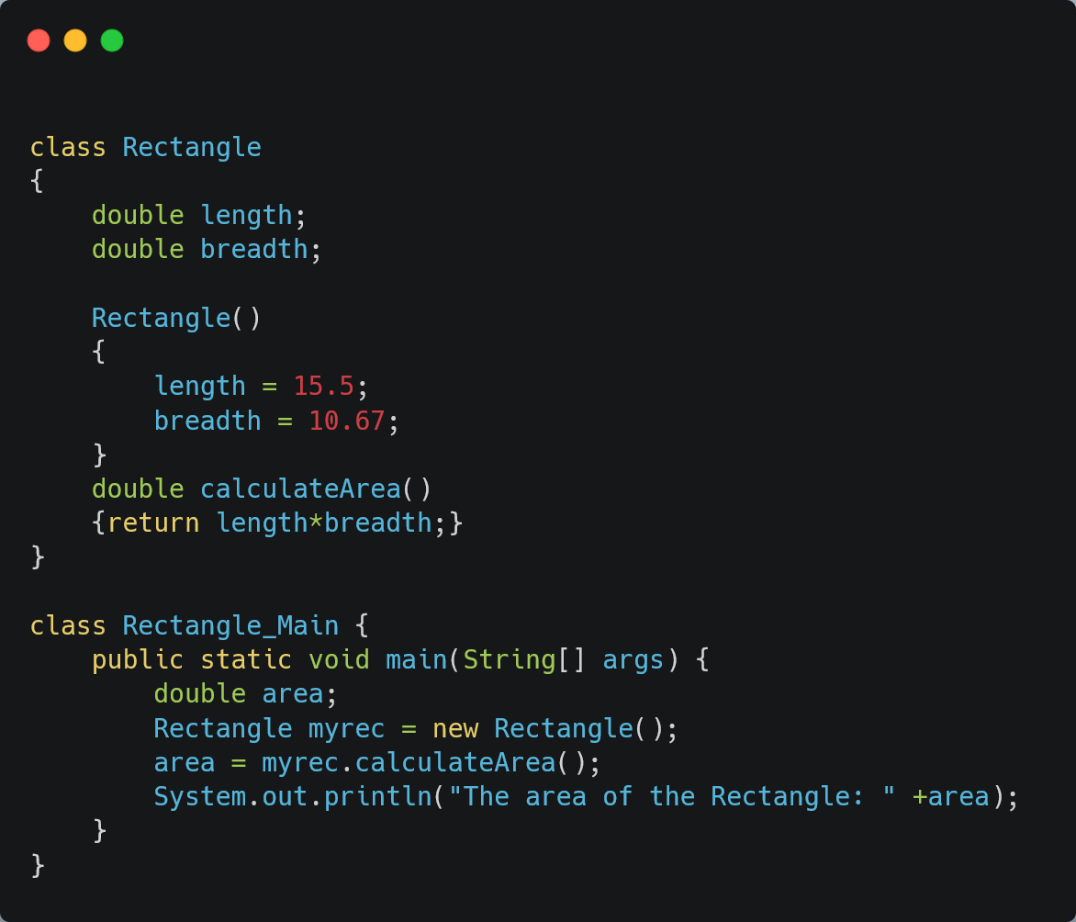
Output:
The area of the Rectangle: 165.385

Slide 14
Parameterized constructor
Unlike, No-argument constructor, it contains parameters (or arguments) in the constructor definition and declaration.
COPY CONSTRUCTOR
A copy constructor is a special type constructor which creates an object using another object of the same class. In return, it gives a copy of an already created object that is copied.

Slide 15
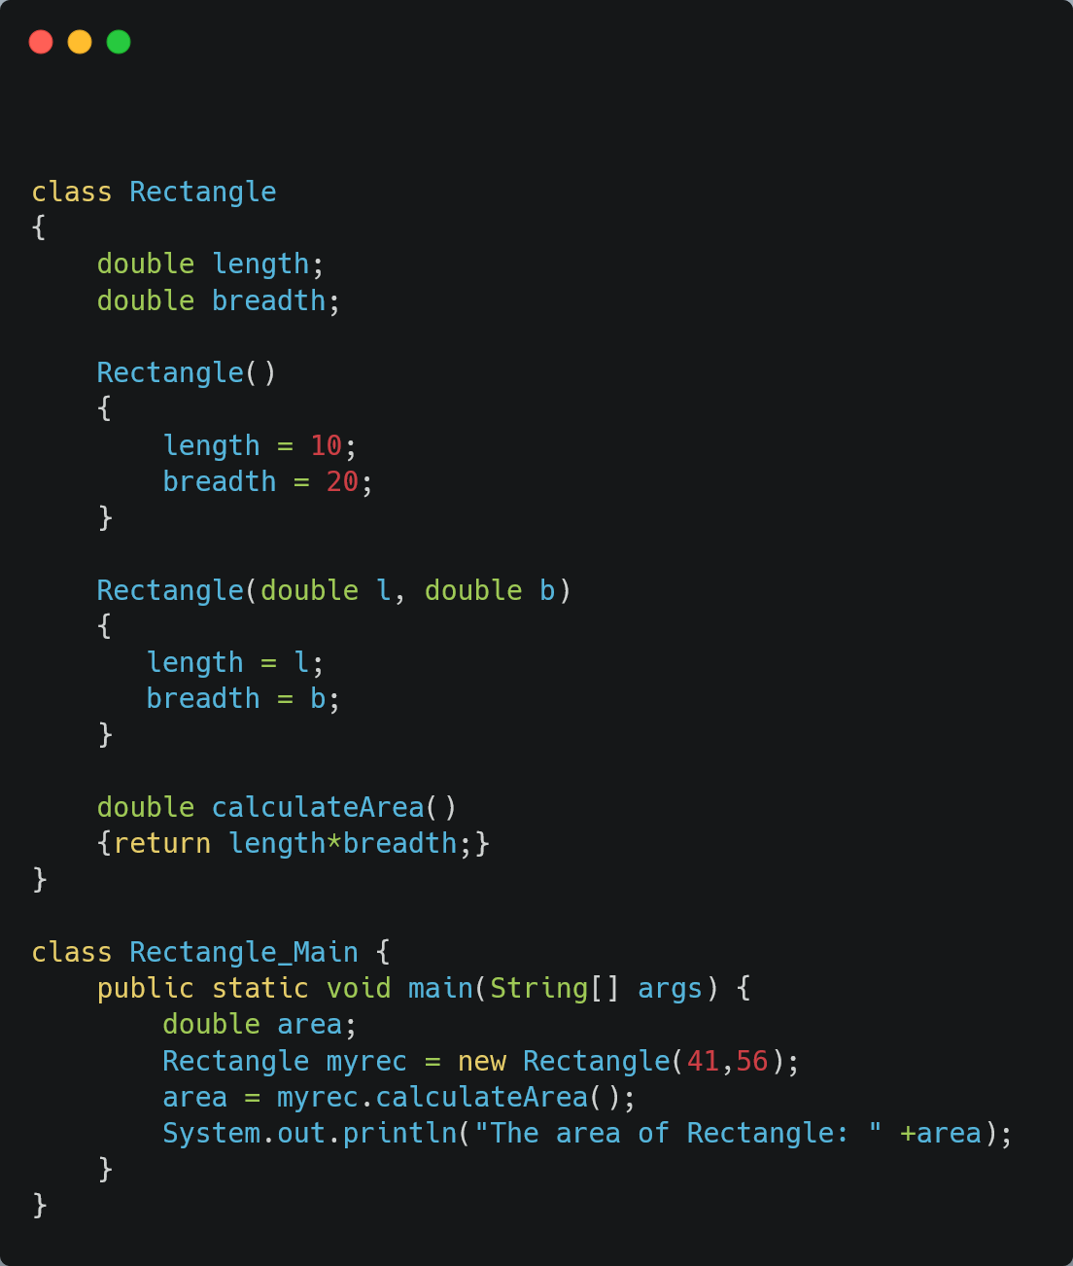
Output:
The area of the Rectangle: 2296.0

Slide 16
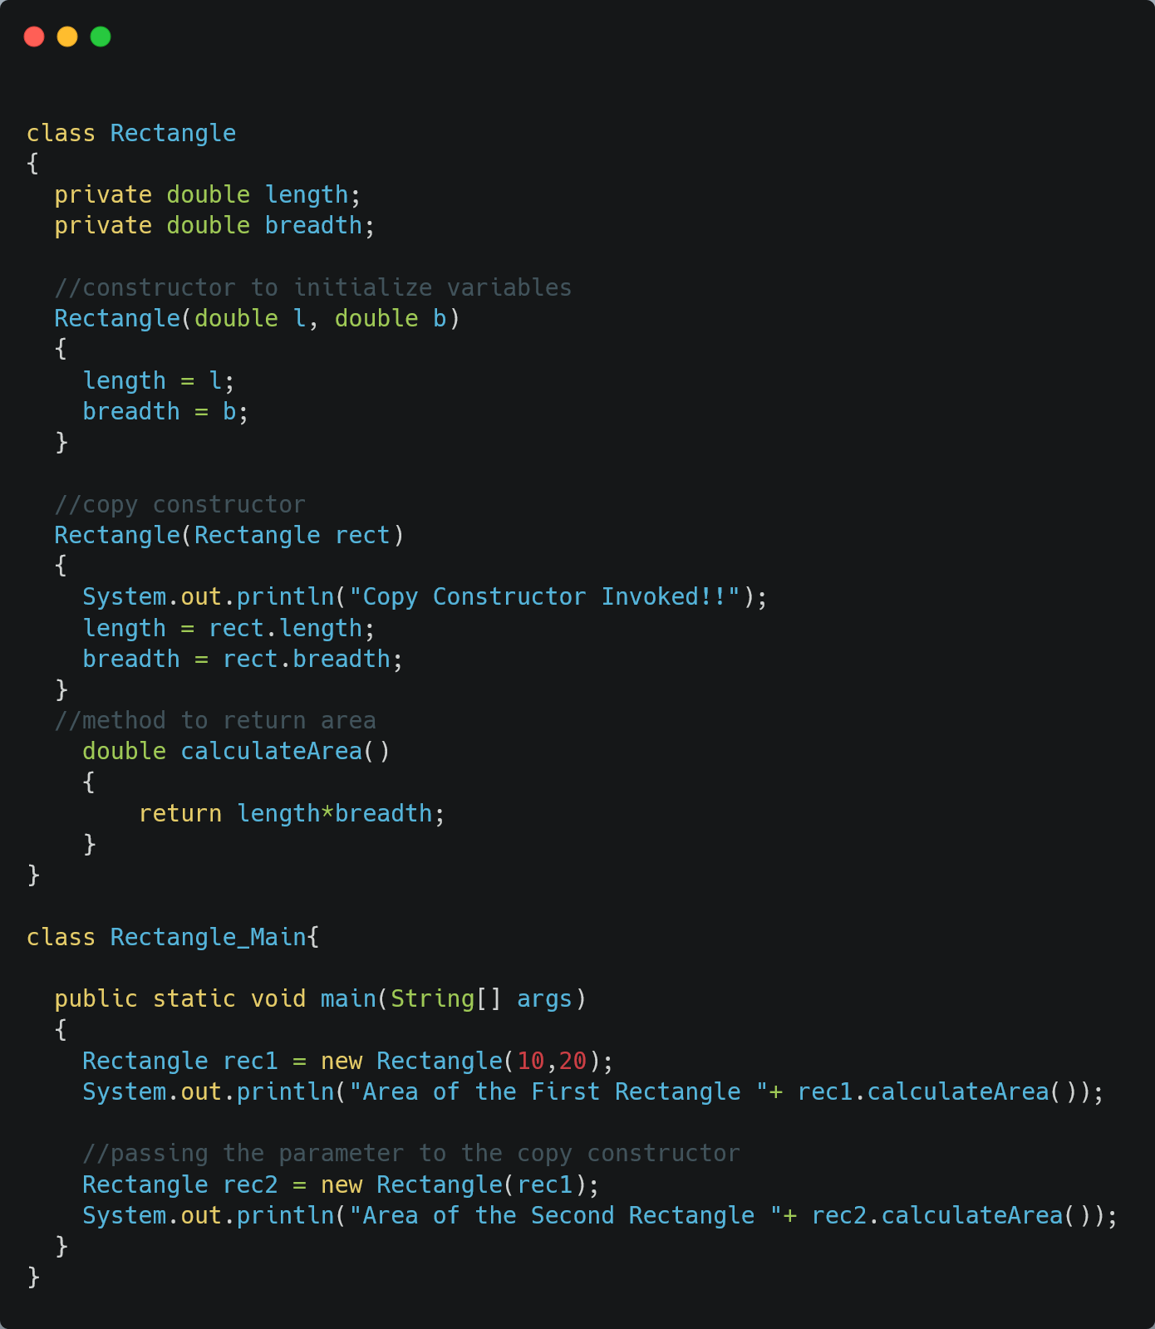
Output:
Area of the First Rectangle 200.0
Copy Constructor Invoked!!
Area of the Second Rectangle 200.0

Slide 17
THANK YOU
Surya Uppara
20384123

